Slide 1
Needfinding for New Grads
CS147 Winter 2021

Slide 2
Table of contents
01
03
05
02
04
06
Team
Participants
Results
Who are we? :)
Who they are and why they were chosen
Quotes +
Say, Think, Do, Feel
Domain
Questions
Insights
Our domain and why we chose it
Initial questions to guide conversation
General conclusions

Slide 3
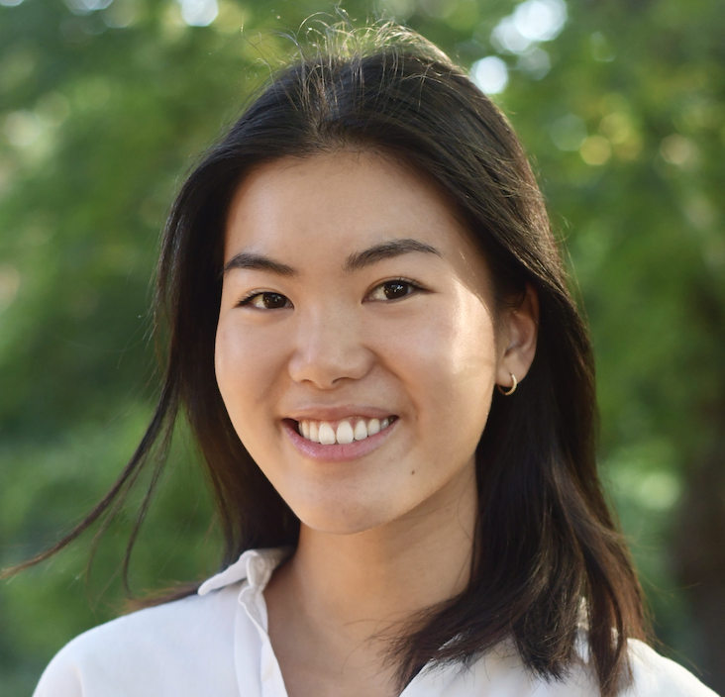
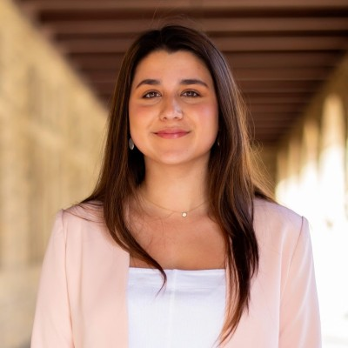
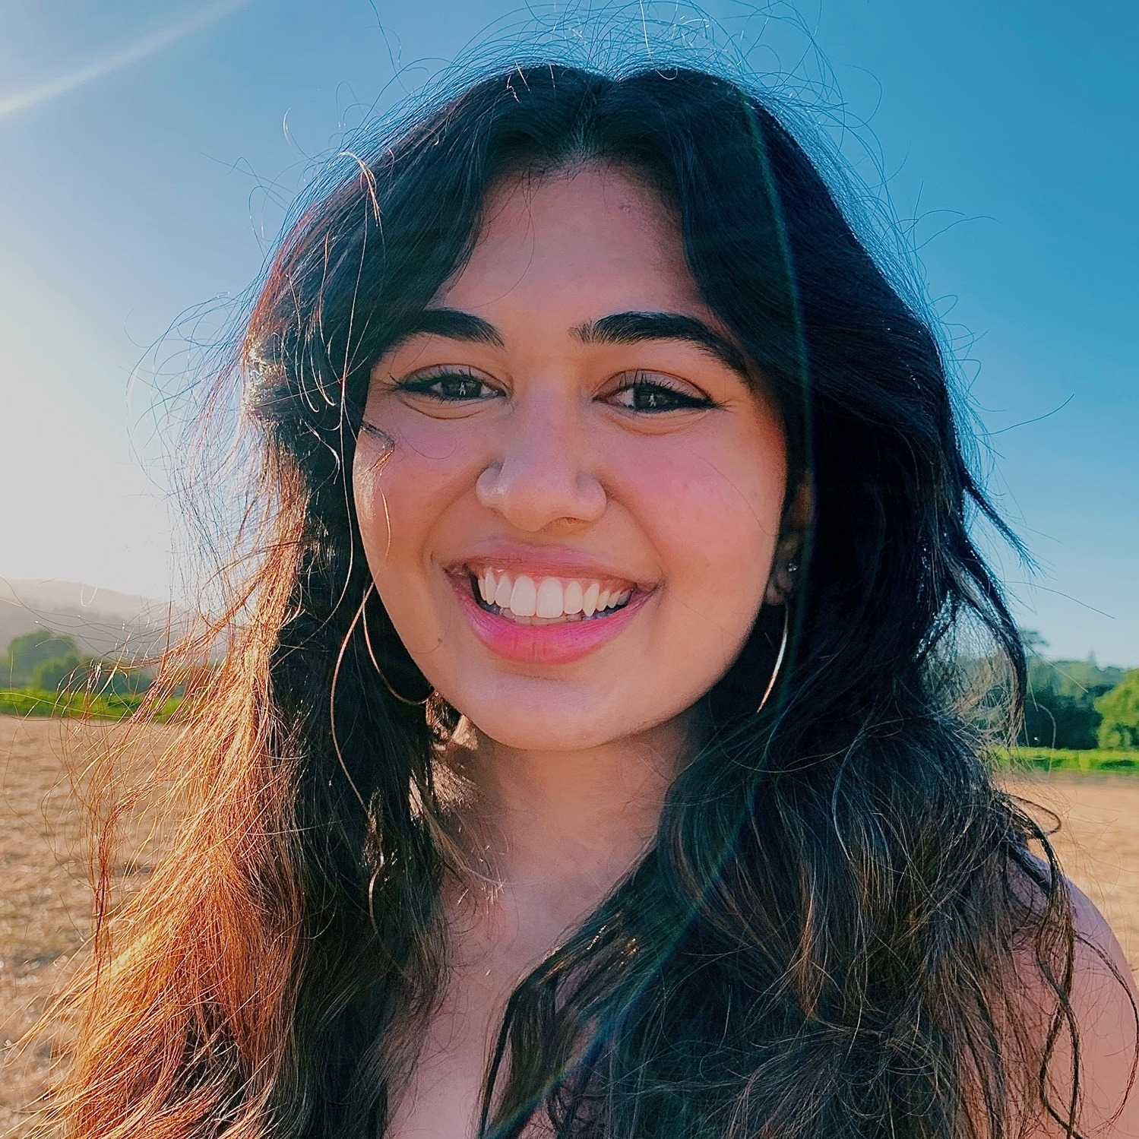
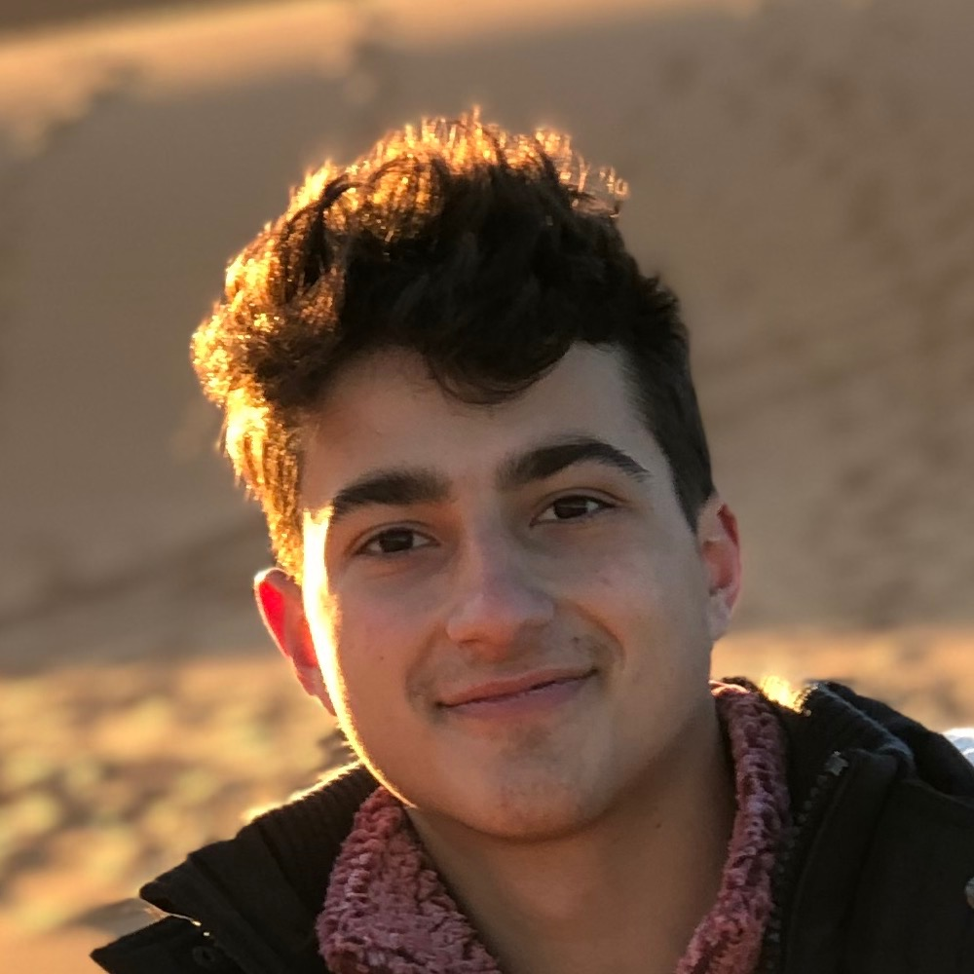
01 Meet the Team
Amy
Tara
Anooshree
Platon
Senior
Computer Science
Boston, MA
Senior
Symbolic Systems
Oakland, CA
Senior
Computer Science
San Jose, CA
Junior
Symbolic Systems
NYC, NY

Slide 4
02 Domain
New Grad
Loneliness
Housing
Intentionality
Dating

Slide 5
03
Participants

Slide 6
Participant Selection
WHO
9 total participants
21-26 years old
Mostly college educated and U.S.-based
HOW
We texted older acquaintances
Set up 20 minute Zoom calls
WHY
Reached outside of Stanford bubble
Diversity of professions
Sample biased by our social connections
Notes:
Tara
All together, we interviewed 9 participants. They were all people who’d moved away from home and started the next stage of their lives. They were all college graduates besides one and all based in the US.
We found these participants by texting older acquaintances to set up interviews and using their connections to find more interviewees. We engaged in 20-30 minute Zoom calls with our participants.
In terms of why we selected the participants we chose, we made an effort to go outside of the Stanford bubble to engage a more diverse set of perspectives. We included one Stanford grad along with people from Boulder, Washington and Lee, UCLA, and so on. This should help us avoid too much Stanford-bias in our sample. Our participants engaged in a variety of professions from tech to finance to ballet. We wanted to achieve as much diversity as possible in career path to avoid biasing our conclusions. However, given that we are all Stanford students, the people we know are already a biased dataset. Thus, there was a skew towards finance careers in our interviews, as well as top 20 colleges. We did our best to reach out to friends of friends and minimize this bias, but it’s important to admit that it’s still present in our data.

Slide 7
Our Participants
Anastasia
1 year out
Professional ballet dancer
Atlanta
Completed college while working
Cares about intentionality and self-care
Hadley:
2 years out
Cybersecurity startup
NY
Former college athlete
Cares about community & activeness
Will:
2 years out
Consulting @ Bain in SF
Used to work in NY but recently moved
Cares about socializing and creating routines for better lifestyles
Joe:
2 years out
Investment Banking
NY
From Canada
Passionate about food and wine
Notes:
Platon
I added stuff abt Hadley if u want to use it but feel free to delete - Tara

Slide 8
What we asked: Our Guiding Questions
Can you walk me through a day in your life as a post grad? What do you spend the most time doing? The most energy?
What was the first thing on your mind after graduating college?
What was the most surprising thing you faced after leaving college?
Can you tell me about a time you struggled with loneliness in your early 20s?
Have you dated as a new grad? How has the experience been different from dating in school?
Notes:
Amy

Slide 9
04
Results

Slide 10
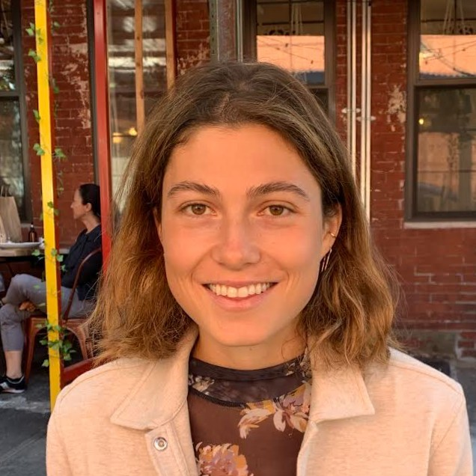
“You wanna know where your friends are gonna be. That’s so noticeable when you graduate: your friends are gone, your community is gone. There’s a sense that you’re waiting to see what other people do.”
Hadley Irwin
24, NYC
Tech startup
Notes:
Hadley said that, as a new grad, she’s thinking a lot about where her friends are and how she can be near them.
When college ends, “your friends are gone and your community is gone,” she says. For Hadley, that meant that after graduation she felt like she was anxiously waiting and trying to figure out where all her friends would end up. She cares about maintaining her long-term connections through big life transitions to avoid loneliness.

Slide 11
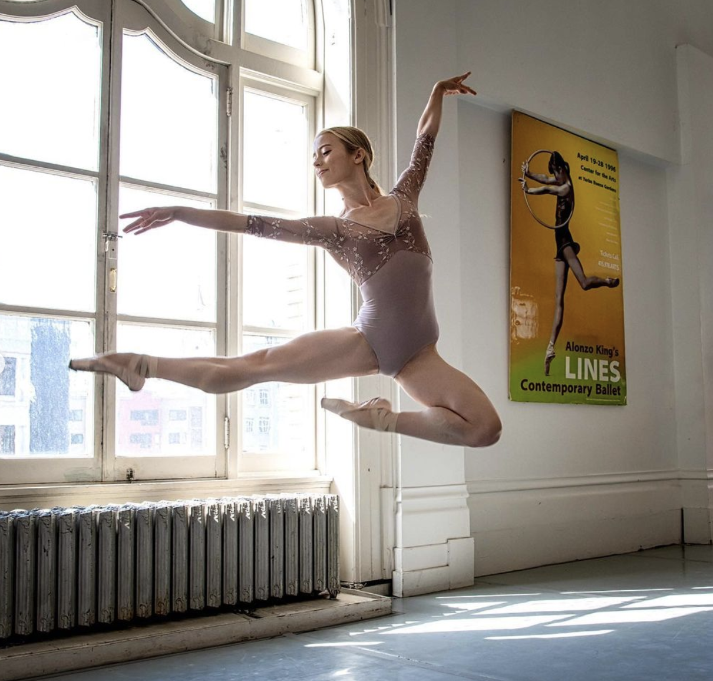
“ I was dating because I was afraid of being lonely. Outside of a school setting, you don’t make as many friends. When you’re young, there’s a lot of uncertainty and that makes finding a partner harder.”
Anastasia Cheplyansky
22, Atlanta
Ballet Dancer
Notes:
Anastasia said that she struggles to combat loneliness when away from her central support systems (family and her friends from school)
[Read quote]
For Anastasia, that meant that she relied on her independence and potential partners to distract from her new life and the infinite possibilities that stretched before her.

Slide 12
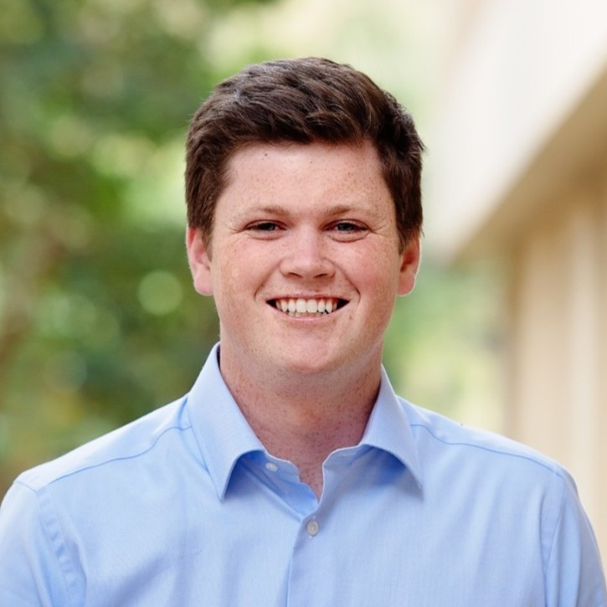
“Divide the week between 2-3 events you want to do throughout the week. Pick 2-3 people you want to talk to. Go have fun. Simple and easy things to look forward to throughout the week.”
Will Kenney
23, SFO
Consultant @ Bain & Company

Slide 13
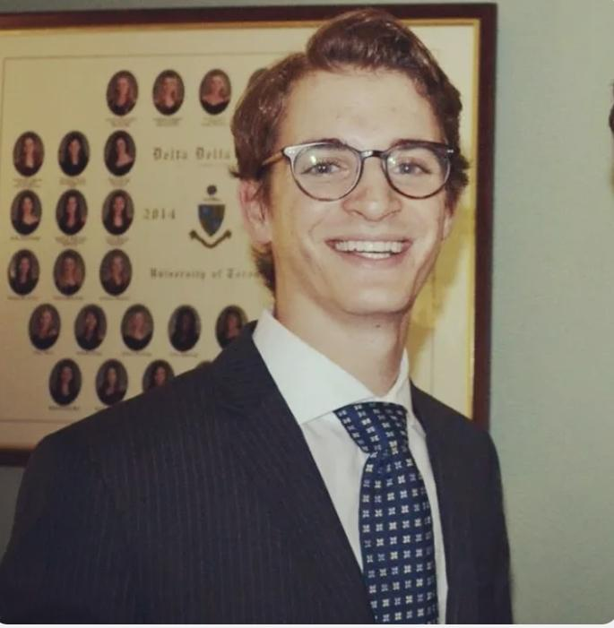
“I now focus on how much can I sneak away from work to do what I want to do (cooking, hanging out, shopping, etc.). I bring my laptop everywhere now and just sometimes do work in cafes. ”
Joe
24, NYC
Investment Banking

Slide 14
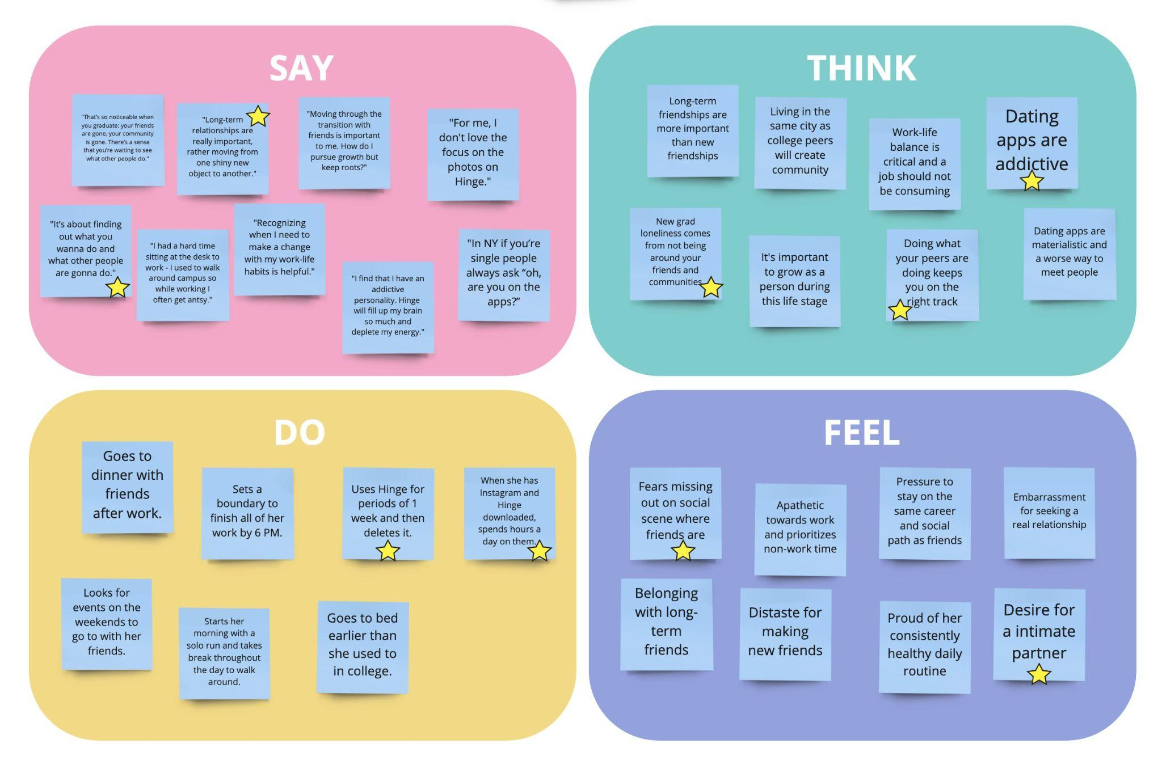
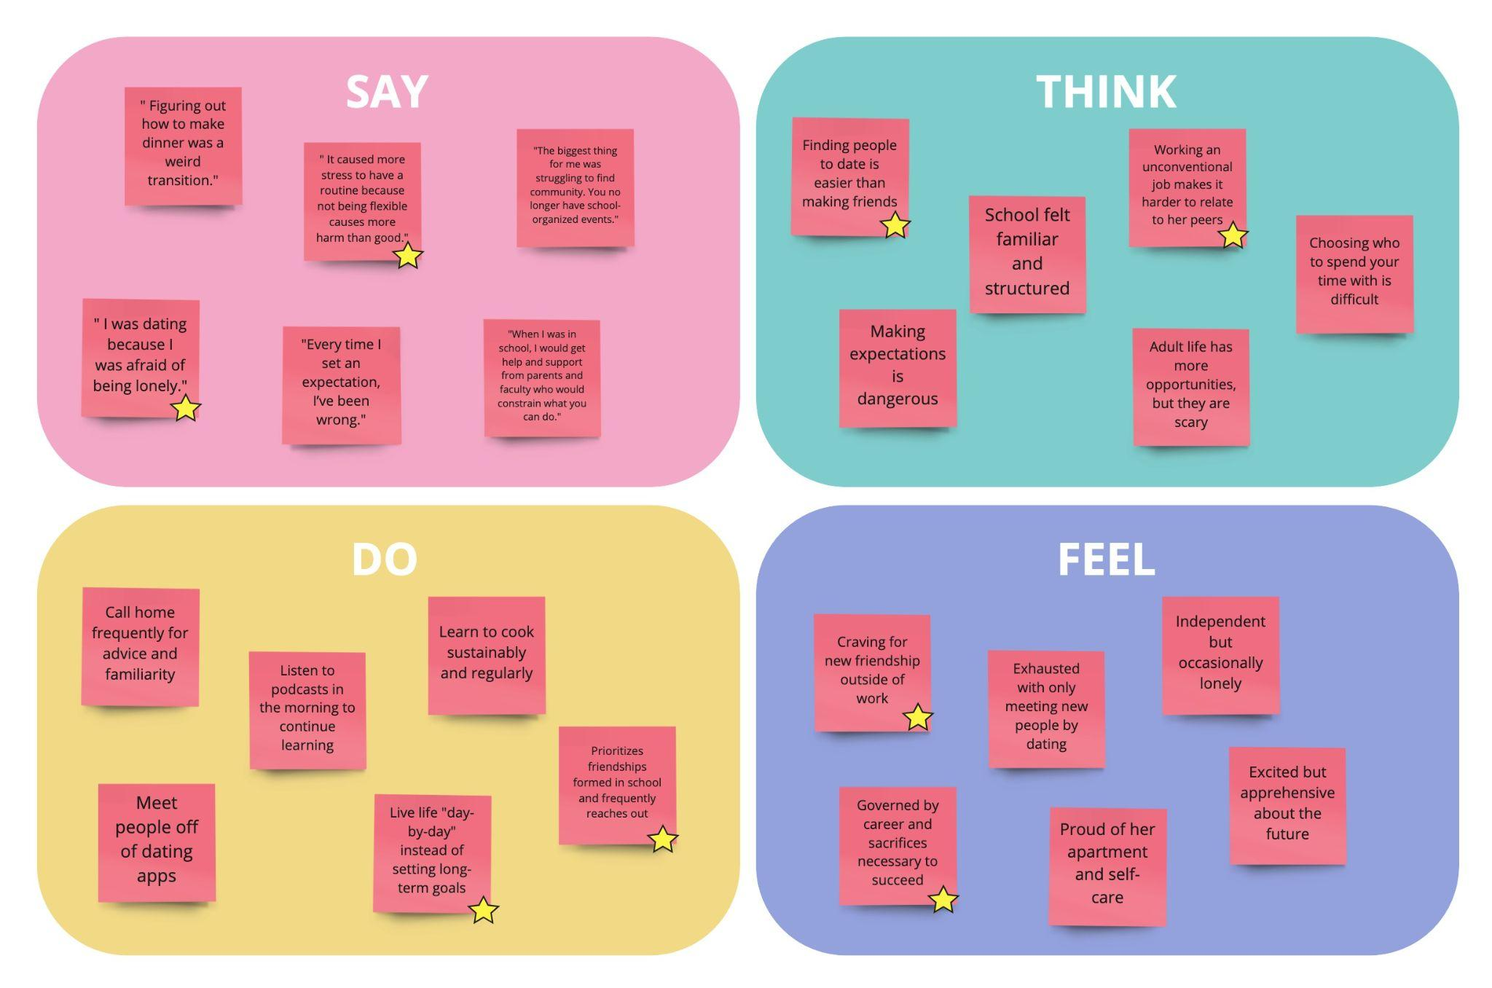
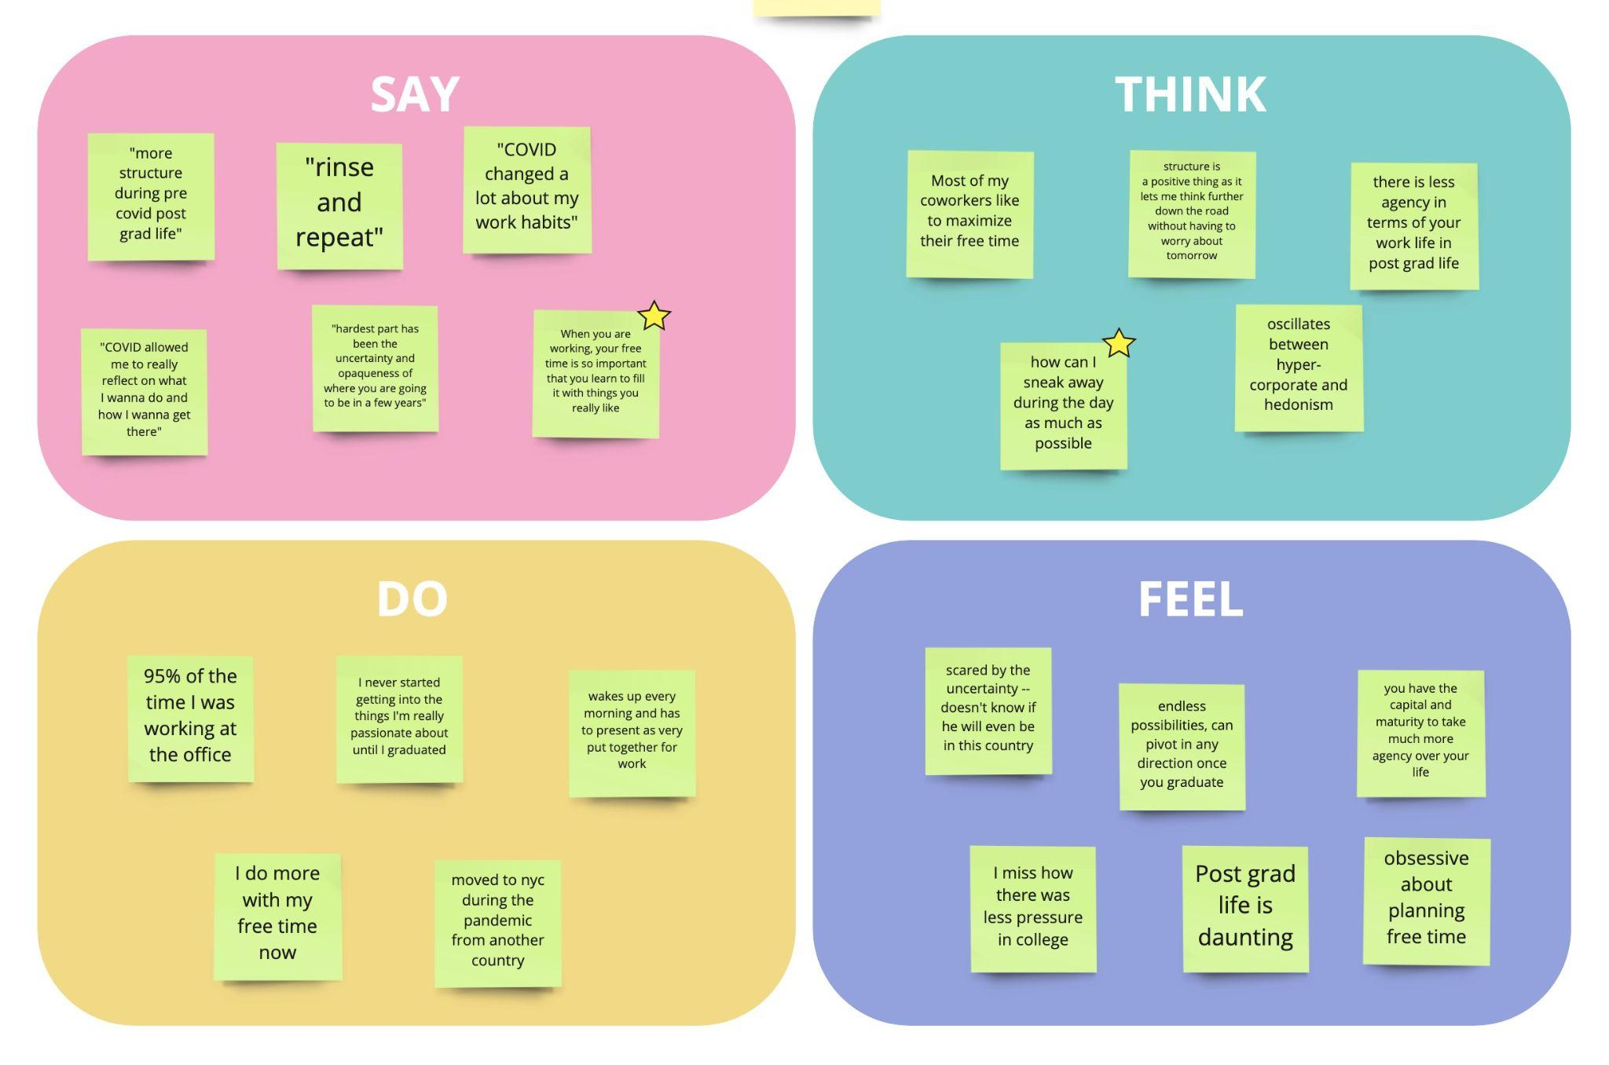
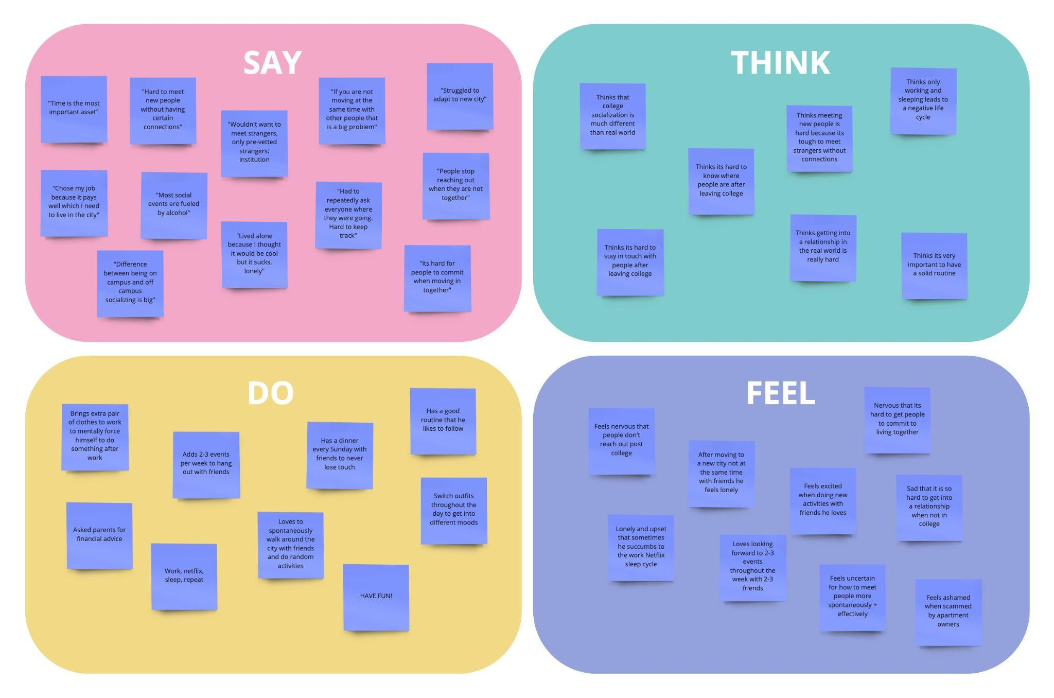
Empathy Map Key Takeaways

Slide 15
Hadley

Slide 16
Anastasia

Slide 17
Hadley
Joe

Slide 18
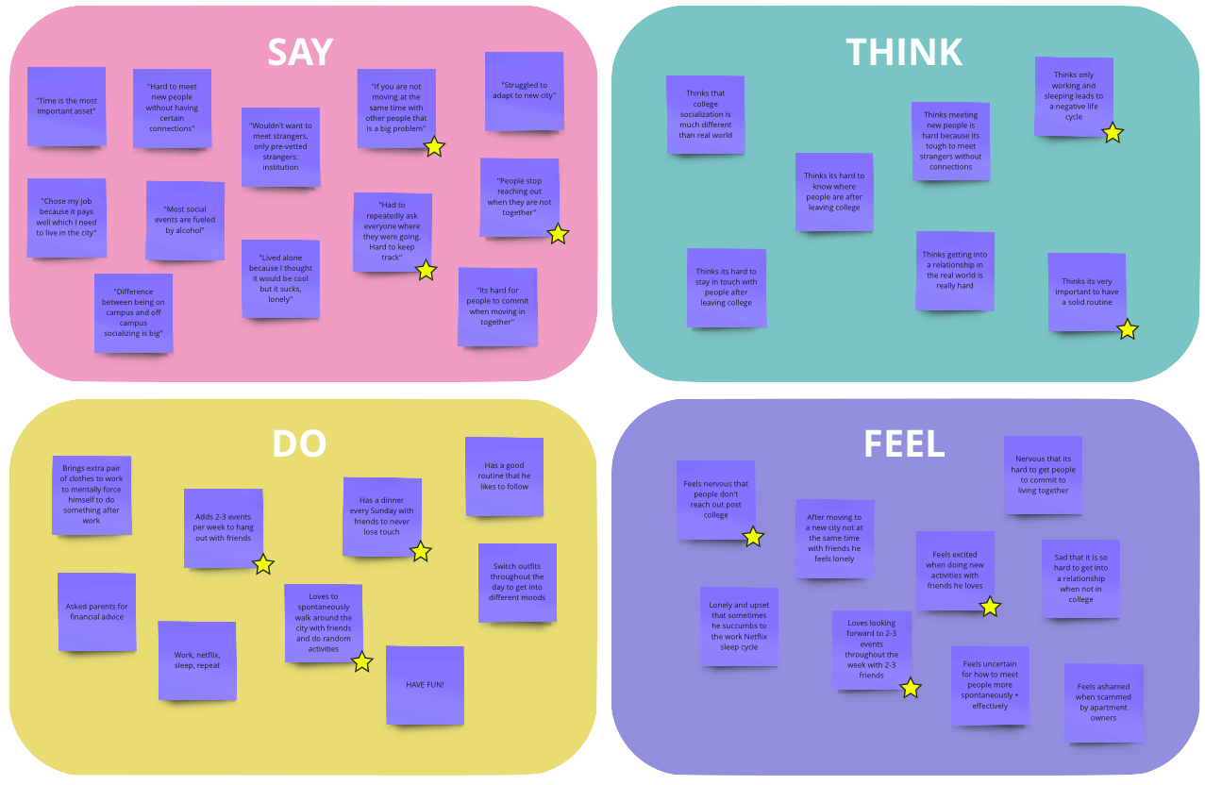
Will

Slide 19
05
Analysis

Slide 20
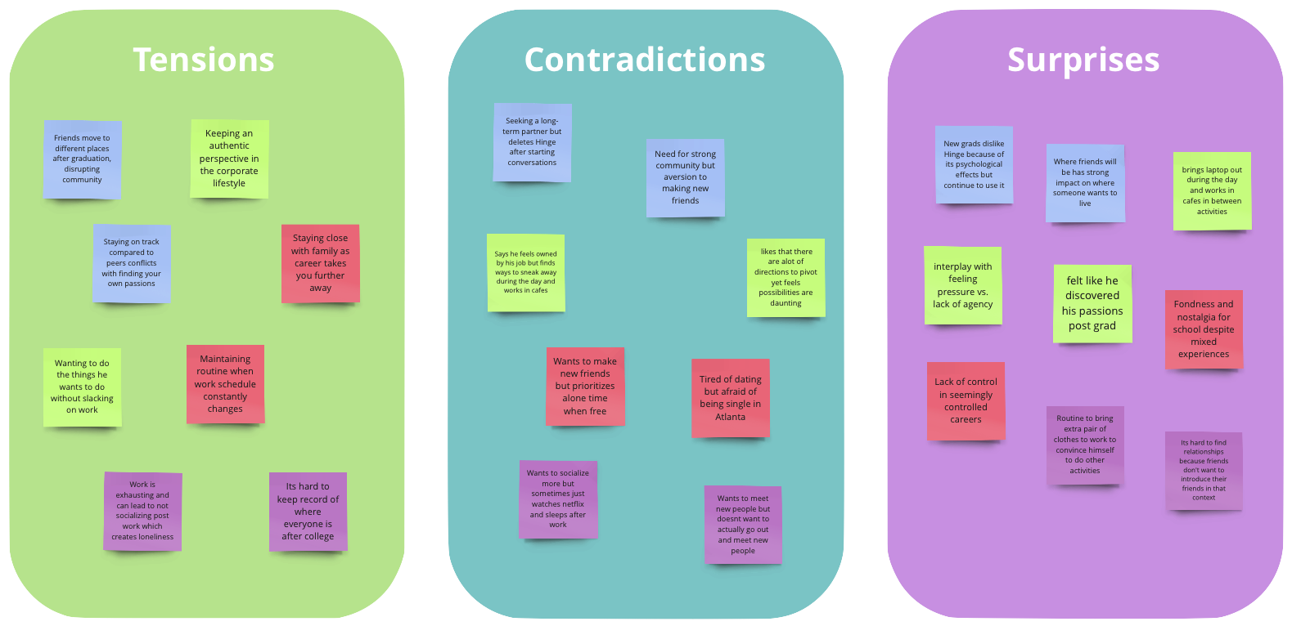
Tensions, Contradictions, Surprises

Slide 21
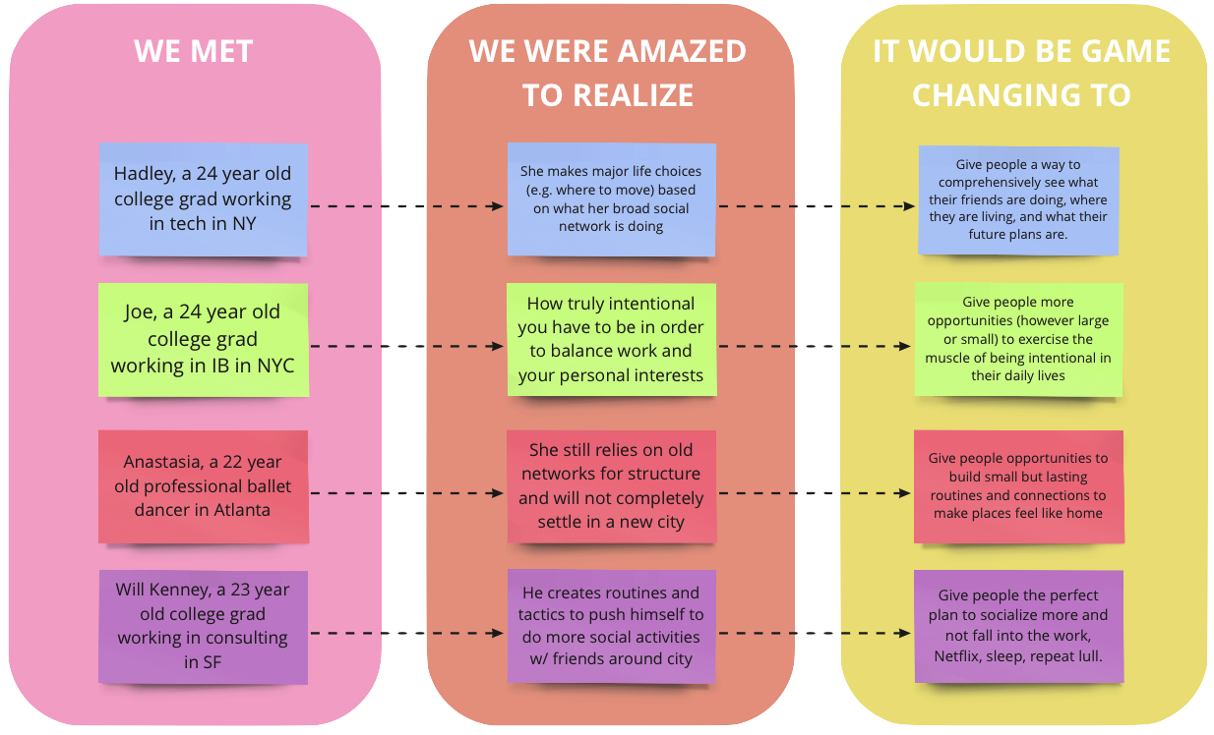
POVs

Slide 22



Potential Needs
Combat post-grad loneliness
Build small but lasting routines
Develop social intentionality
Date without psychological side effects
Notes:
Tara

Slide 23
Questions/Next Steps
Investigate more extreme users
Solidify “How Might We” statements
Seek out more interviewees
Visualize our data in different ways
Brainstorming and experience prototyping
Notes:
Anooshree

